Slide 1
FUNDAMETALS OF ANALOGUE ELECTRONICS EE/TE 8204 RECTIFIER DIODES L1 CREDITS 6

Slide 2
introduction
A rectifier is an electrical device that converts alternating current (AC), which periodically reverses direction, to direct current (DC), which is in only one direction, a process known as rectification.

Slide 3
Types of Rectifiers
Half wave Rectifier
Full wave Rectifier
Bridge Rectifier

Slide 4
Lecture Outline
Half wave Rectifier
Full wave Rectifier
Bridge Rectifier

Slide 5
Half wave rectifier
In half wave rectification, either the positive or negative half of the AC wave is passed, while the other half is blocked.
Because only one half of the input waveform reaches the output, it is very inefficient if used for power transfer. (disadvantage)

Slide 6
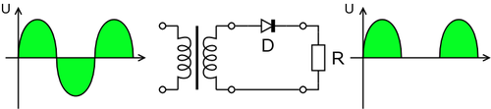
Half wave rectification

Slide 7


Output dc voltage calculation
The output DC voltage of a half wave rectifier can be calculated with the following two ideal equations

Slide 8
Half wave rectification

Slide 10
Effect of the Barrier Potential on the Half-Wave Rectifier Output
When the practical diode model is used with the
barrier potential of 0.7 V taken into account, this is
what happens. During the positive half-cycle, the
input voltage must overcome the barrier potential
before the diode becomes forward-biased. This results
in a half-wave output with a peak value that is 0.7 V
less than the peak value of the input, as shown in
Figure 2–23. The expression for the peak output voltage is

Slide 11
Figure 2–23.

Slide 12
Peak Inverse Voltage (PIV)
The peak inverse voltage (PIV) equals the peak value
of the input voltage, and the diode must be capable of
withstanding this amount of repetitive reverse voltage.
For the diode in Figure 2–26, the maximum value of
reverse voltage, designated as PIV, is maximum voltage a diode or other device can withstand in the reverse-biased direction without damaging itself.
A diode should be rated at least
20% higher than the PIV.
(advantage and definition)

Slide 14
Full wave rectification
For single-phase AC, if the transformer is center-tapped, then two diodes back-to-back (i.e. anodes-to-anode or cathode-to-cathode) can form a full-wave rectifier.

Slide 15
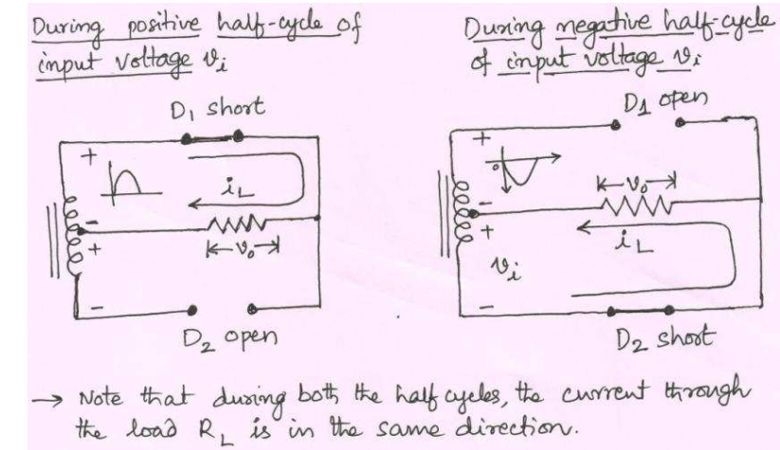
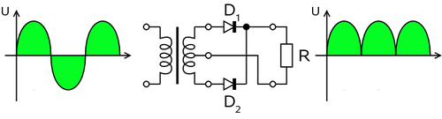
Full wave rectifier using transformer and 2 diodes

Slide 16
Effect of the Turns Ratio on the Output Voltage
If the transformer’s turns ratio is 1, the peak value of the
rectified output voltage equals half the peak value of the
primary input voltage less the barrier potential, as
illustrated in Figure 2–33. Half of the primary
voltage appears across each half of the secondary winding
(Vp(sec) = Vp(pri)). We will begin referring to the forward
voltage due to the barrier potential as the diode drop. In
order to obtain an output voltage with a peak equal to the input
peak (less the diode drop), a step-up transformer with a turns ratio
of n = 2 must be used, as shown in Figure 2–34. In this case, the total secondary voltage (Vsec) is twice the primary voltage
(2Vpri), so the voltage across each half of the secondary is equal to Vpri.
In any case, the output voltage of a center-tapped full-wave rectifier is
always one-half of the total secondary voltage less the diode drop, no
matter what the turns ratio.

Slide 17
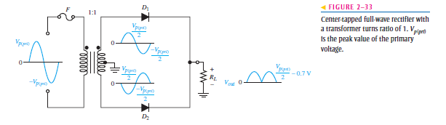

Slide 18
Full wave rectification
In a circuit with a non - center tapped transformer, four diodes are required instead of the one needed for half-wave rectification.

Slide 20
Peak Inverse Voltage
Each diode in the full-wave rectifier is alternately
forward-biased and then reverse-biased. The maximum
reverse voltage that each diode must withstand is the
peak secondary voltage Vp(sec). This is shown in Figure
2–35 where D2 is assumed to be reverse-biased (red) and
D1 is assumed to be forward-biased (green) to illustrate the
concept. When the total secondary voltage Vsec has the
polarity shown, the maximum anode voltage of D1 is -Vp(sec)
2 and the maximum anode voltage of D2 is -Vp(sec)/2. Since
D1 is assumed to be forward-biased, its cathode is at the same
voltage as its anode minus the diode drop; this is also the voltage
on the cathode of D2. The peak inverse voltage across D2 is

Slide 21


Slide 23
Full wave rectifier working animation

Slide 24


formula
The average and root-mean-square output voltages of an ideal single phase full wave rectifier can be calculated as:

Slide 25
Output voltage of the full wave rectifier Animation

Slide 26
Bridge rectifier
A bridge rectifier makes use of four diodes in a bridge arrangement to achieve full-wave rectification.

Slide 27
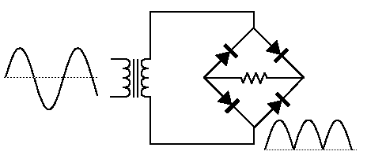
Bridge rectifier circuit

Slide 28
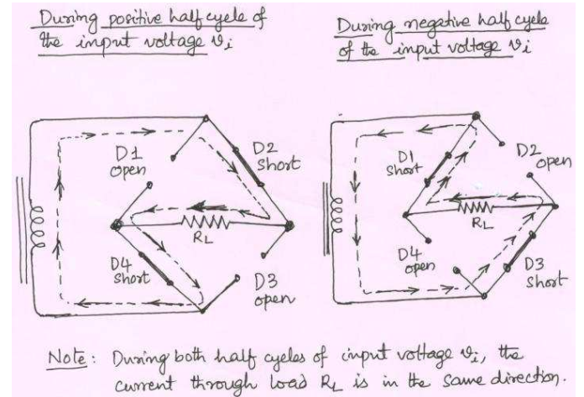
Bridge rectifier working animation

Slide 29
Assignment 1 ( 8 groups)
1. Schottky Diode
2. The PIN Diode
3. The Step-Recovery Diode
4. Zener diode
5. Light Emitting Diode (LED)
6.Photo diode
7. Tunnel diode
8.Varactor diode

Slide 30
DIODE APPLICATIONS
Here are a few of the typical applications of diodes include:
Rectifying a voltage, such as turning the AC into DC voltages.
Isolating signals from a supply.
Voltage Reference.
Controlling the size of a signal.
Mixing signals.
Detection signals.
Lighting systems.
LASER diodes.

